Slide 1
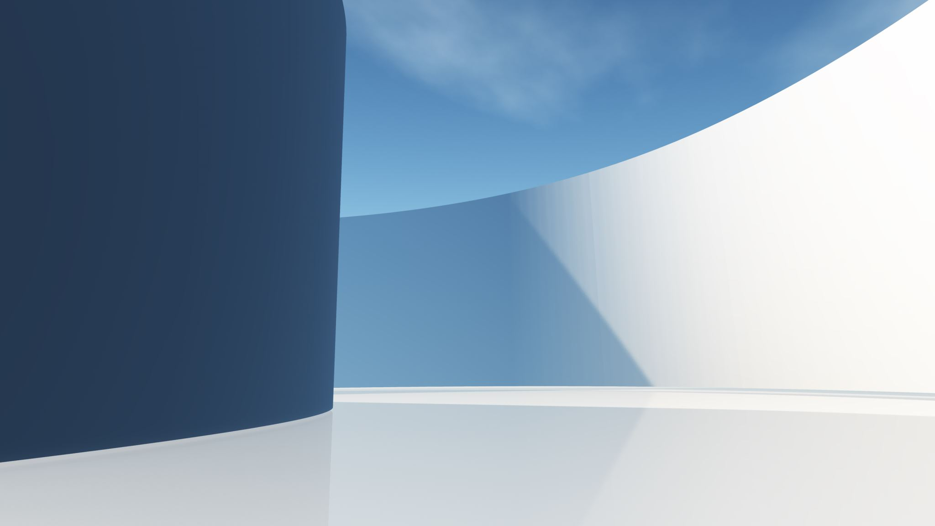
CS410 PNNL P3
2/3 Update Alea M.

Slide 2
Updates
3D models
Initial print
Mock base
Starting controls

Slide 3
